Slide 1
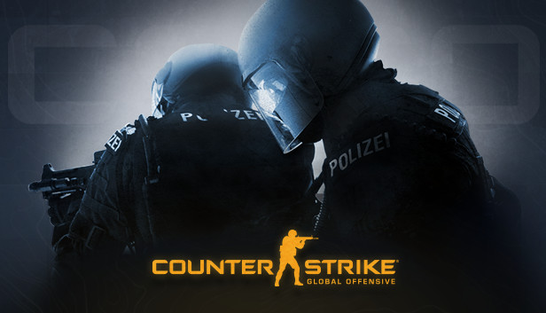
Predicting CS:GO Round Winners With Deep Learning
by Andrew Dettor
Notes:
Photo credit: https://www.google.com/url?sa=i&url=https%3A%2F%2Fstore.steampowered.com%2Fapp%2F730%2FCounterStrike_Global_Offensive%2F&psig=AOvVaw2XgsX3Bbq2Ny8xtvG_70zB&ust=1670962053972000&source=images&cd=vfe&ved=0CA8QjRxqFwoTCLjw1_Dw9PsCFQAAAAAdAAAAABAP

Slide 2
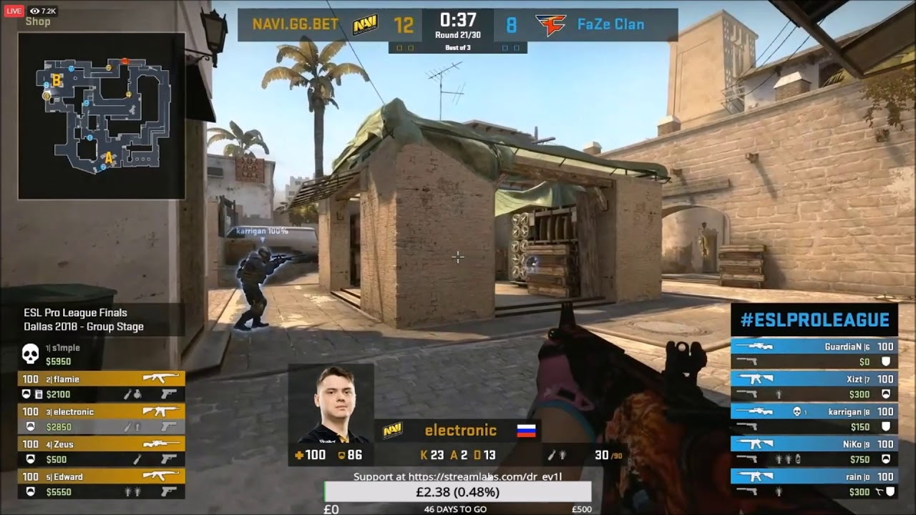
What is CS:GO?
5v5 tactical first-person shooter
E-sport
Terrorists vs. Counter Terrorists
Match is split into rounds
Switch sides after 15 rounds
First team to win 16 rounds wins the match
Dataset
CS:GO Competitive Matchmaking Data from Kaggle
Notes:
Photo credit: https://www.google.com/url?sa=i&url=https%3A%2F%2Fdmarket.com%2Fblog%2Fhow-to-rank-up-csgo%2F&psig=AOvVaw0w-wHuxSMYWs-js4BSPZV2&ust=1670963571872000&source=images&cd=vfe&ved=0CA8QjRxqFwoTCJjgo8T29PsCFQAAAAAdAAAAABAJ

Slide 3
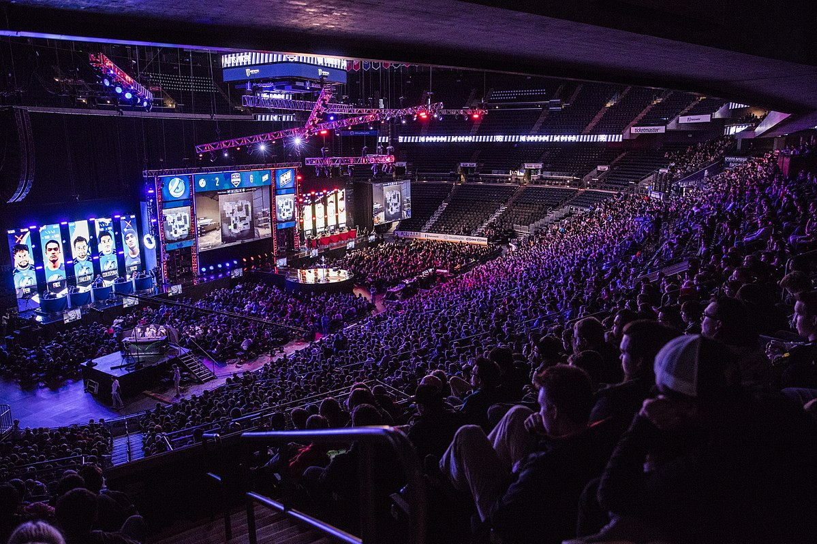

Problem(s) at Hand
Live betting services for e-sports
Bet on matches that are in progress
Predict the winner of the next round
Improving your own play
What features lead to more round wins?
Multi-channel variable-length multiple time-series classification problem with missing data and missing labels
Notes:
Photo credits: (top) https://upload.wikimedia.org/wikipedia/commons/thumb/d/d9/MLG_Columbus_-_Luminosity_vs_Navi.jpg/1200px-MLG_Columbus_-_Luminosity_vs_Navi.jpg
(bottom) https://www.google.com/url?sa=i&url=https%3A%2F%2Fvitality.gg%2Fen%2Fpartners%2Fgg-bet%2F&psig=AOvVaw2K4xn4EPdMM2vJaVcN2ZMQ&ust=1670963901266000&source=images&cd=vfe&ved=0CBAQjhxqFwoTCMDNtOH39PsCFQAAAAAdAAAAABAJ

Slide 4
…What?
Multi-channel
Many covariates with round winner (round length, each side’s total $, etc)
Variable-length
Matches can be anywhere from 14 (forfeit) to 30 rounds
Multiple
Many samples
Time-series
Matches are separated into rounds
Classification
Predict if T’s or CT’s win the next round
Missing data and missing labels
Some rounds were missing entirely

Slide 5
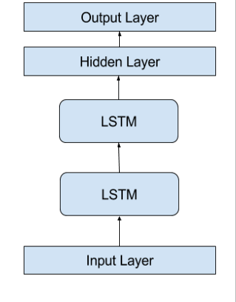
Deep Learning Approach
LSTM
Data of shape: (matches x rounds x features)
2 GRU layers w/ 16 hidden units
Dense layer w/ Sigmoid
Validation Strategy
Feed rounds 1 to N-1 then predict winner of round N
Split matches into train/test/valid
Missing data
Fill in each feature with its average for that round
Missing labels
Mask missing labels in loss and accuracy calculations
Notes:
Don’t go into too much detail on validation strategy
Photo credits: https://miro.medium.com/max/1204/1*qvdnPF8ETV9mFdMT0Y_BBA.png

Slide 6


Classification Results
65% test set accuracy
Better than chance! (50%)
59% precision, 63% recall
Quite balanced classifier
Confusion Matrix
Notes:
Say there are many features that decide rounds that weren’t captured in the dataset (e.g. individual player skill, positioning on the map, team strategy, etc).
Photo credit: https://i.imgflip.com/2i8ld7.jpg

Slide 7
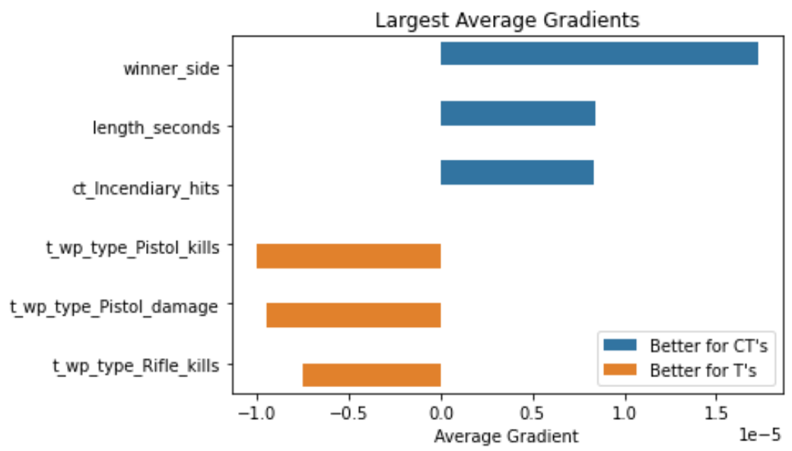
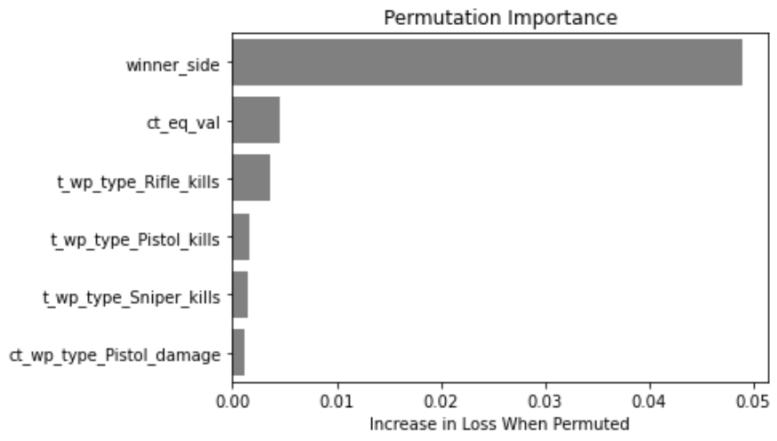
Feature Importance
Features’ Average Gradients (model-based)
Permutation Importance (model-agnostic)
Notes:
Say that winner_side is the winner of this round. We are predicting the winner of the next round.
The gradients especially line up with common wisdom from the game. CTs defend from Ts, so they try to draw out the round, making rounds where they win longer. When CTs are doing well, they can afford the expensive incendiary grenades, which allow them to do even better. CTs were encoded as 1 and Ts as 0, so it makes sense that winner_side’s gradient is highly positive. The team who is winning most of the rounds is likely to win more.
Permutation importance didn’t capture much. It just emphasized that the winner of previous rounds is important for guessing who’ll win the next round.

Slide 8
Conclusions
Questions?
Problem was difficult to translate to Deep Learning
Model performance above random chance
Wouldn’t use it for betting though…
Both feature importance methods align with common wisdom from the game
Correlation vs. Causation

